Slide 1


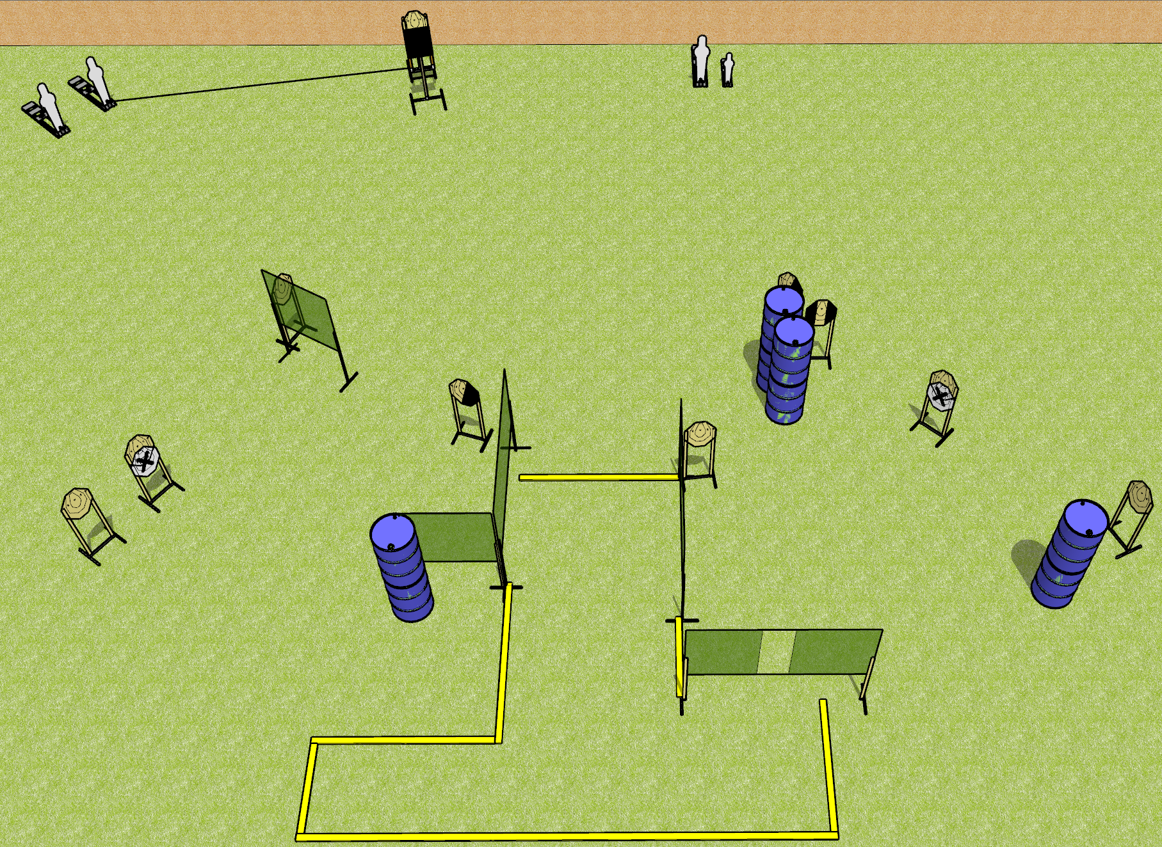
 | Dothan Gun Club – USPSA Match Something Classic Course Designer : Drew Coleman
Round Count 24 rounds 2 colt poppers, 2 mini poppers 10 IPSC
Equipment List 2 4’ walls either side of pull port (instead of port wall) Use swinger instead of bobber Build it like classic nationals 9 targets (7 + 2 NS) 1 left + 1 right diag, 1 tux (mix and match while posting targets) Use 2 colts and a mini instead of pepper poppers READ THE NOTES DURING SETUP!!!

Slide 2
Something Classic
Written Stage Briefing
Scoring: Comstock
Targets: 10 IPSC, 4 poppers
Rounds: 24
Handgun start position: feet on marks, wrists below belt, handgun loaded and holstered.
PCC start position: feet on marks, stock on belt, loaded.
Procedure: on the audible start signal, engage targets as they become available from within the shooting area. Swinger is activated by popper.

